Slide 1

are not bohring!

Slide 2
Review From Last Class
Atomic Number = # of Protons
Atomic Mass = (# of Protons) + (# of Neutrons)
(# of Neutrons) = Atomic Mass - (# of Protons)
(# of Electrons) = (# of Protons)

Slide 3
Review From Last Class
Protons
  “Live” in the nucleus
  Have positive charge (P⁺)
Neutrons
  “Live” in the nucleus
  Have neutral (no) charge (N⁰)
Electrons
  Have negative charge (e⁻)
  “Live” outside the nucleus
  We will learn today that they follow special rules

Slide 4
Bohr Rutherford Diagrams
Ex. Fluorine
Write how many protons and neutrons are in the nucleus.
Draw electrons in rings (energy shells) around the nucleus.
19
F
9
9p+
10 n

Slide 5
Bohr- Rutherford Diagrams
Write the # of protons and neutrons in the nucleus.
The 1st electron energy shell has a maximum of 2 electrons.
The 2nd electron energy shell has a maximum of 8 electrons.
The 3rd electron energy shell has a maximum of 8 electrons.
18p⁺
22n⁰
Argon

Slide 6
Electron Shell Rules
Electron shells are filled from the inside outwards
Start placing electrons until you run out
  # Electrons = # Protons
Each shell can hold only so many
  1st shell: 2 maximum
  2nd shell: 8 maximum (10 total)
  3rd shell: 8 maximum (18 total)
  4th shell: ???

Slide 7
Try It - Hydrogen
How Many Electrons?
  1
Try the 1st shell
Are we out of electrons?
YES
1p⁺
0n⁰

Slide 8
Try It - Carbon
How Many Electrons?
  6
Try the 1st shell
Full!
Try the 2nd shell
Are we out of electrons?
YES
6p⁺
6n⁰

Slide 9
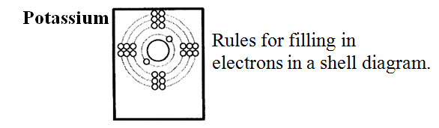
Try It – Your Turn
Electron Shell Worksheet
Example:
Proton # = 19
Electrons # = 19

Slide 10
Textbook References
Bohr-Rutherford Model
  Page 92-93
Subatomic Particles
  Page 87-89

